Slide 1
Modelling Assignment
Abid Hamza
Andruetto Claudia
Barzmehri Mahdi

Slide 2
Building Model
Downstairs and surroundings zones
Windows and radiators
Internal gains
Extra energy and losses
Efficiency of heat exchanger (0.75)
Air infiltration, wind driven (1 l/sm2)
Window frame (0.25)
Thermal bridges to typical values

Slide 3
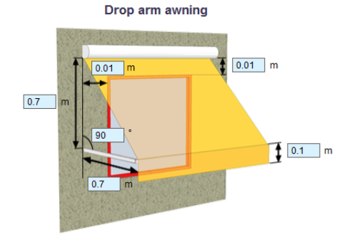
Shading and Daylight
Drop arm awning
The length is adjusted based on the different sizes of the windows
The control is sun + schedule (summer)
Only in the rooms where it is needed
Mirror surfaces on all the walls

Slide 4
Cold Climate - Stockholm

Slide 5
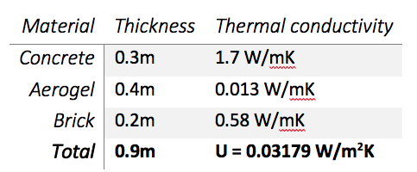
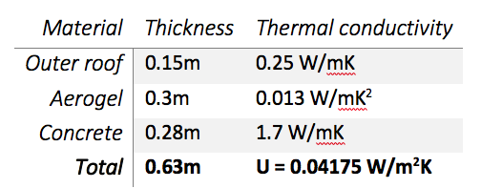
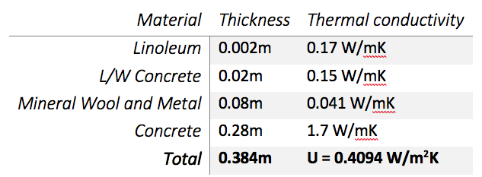
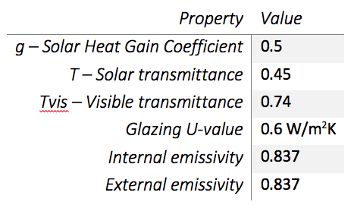
Insulation and windows
External Walls
Internal Floor
Roof
Windows

Slide 6
Heating and cooling system
Added heating/cooling systems (floor heating and cooling) in some zones, for a total of 5149.8 W of heating and cooling
Window opening schedule is set to PI control and summer to help cooling in the summer (the windows are open only during the period March 1st to November 1st if the temperature inside is higher than the setpoint (which is 24°C) and it is higher the outside temperature)

Slide 7
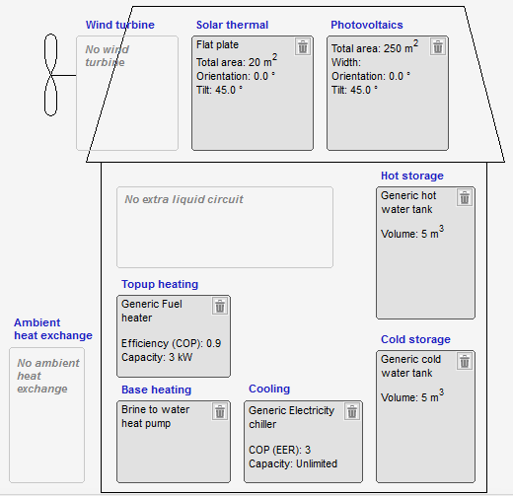
Heat Pump and Solar Thermal
Base heating: 35kW
Top-up heating: 3kW (10% of base heating)
Heat pump: Brine to Water
Ground heat exchange: 2 holes, length of 75m
Solar plates: area of 20m2

Slide 8
Results
Operating temperature | Higher than 21°C in winter and lower than 24°C in summer
CO2 | Values below 1000 ppm (vol.), as asked by the requirements
Total heating (excluding surroundings and downstairs) | 31 kW 41 W/m2 → SILVER
Total cooling (excluding surroundings and downstairs) | 41 kW 54 W/m2
PPD% | Less than 8% in all rooms
Solar gain | Max solar gain of 50 W/m2 in Zone 46 All other zones are below 35 W/m2
BBR | HVAC = 23.57 kWh/m2; Equipment = 7.306 kWh/m2 BBR = 49.38, less than 1.0 BBR (=85.64) → GOLD (Energy class C)

Slide 9
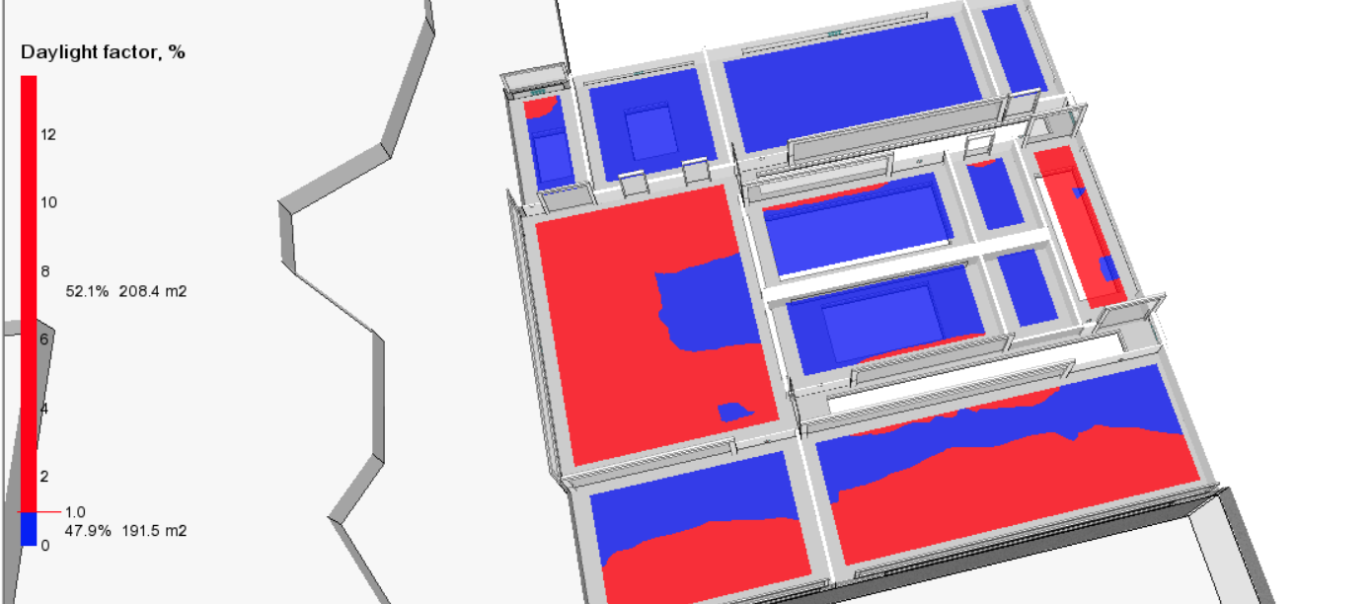
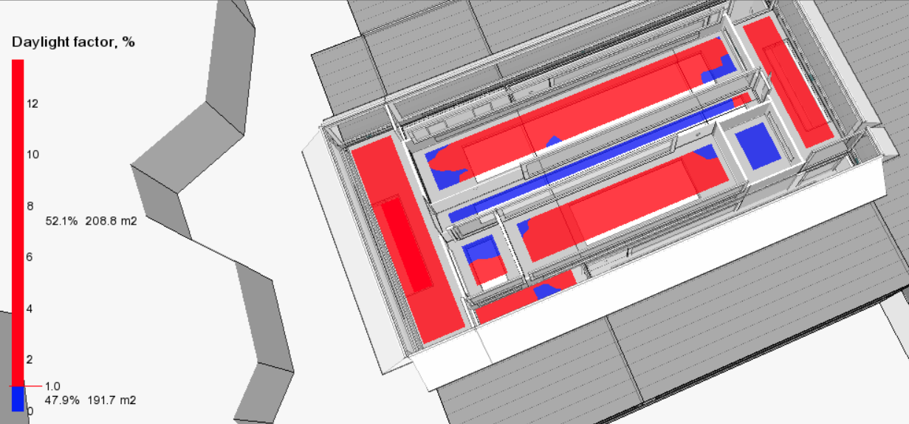
Daylight results
Upper floor Main floor
Daylight median is more than 1% in mostly all the rooms with windows

Slide 10
Warm Climate - Roma

Slide 11
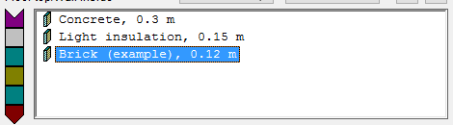
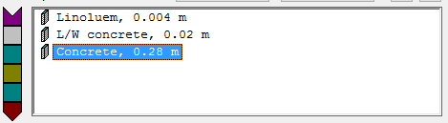
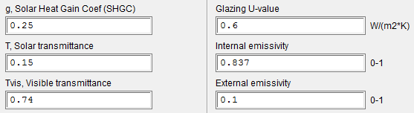
Insulation and windows
External walls
U = 2.034 W/m2K
Thickness = 0.304
Wi
Windows
Roof
U = 2.034 W/m2K
Thickness = 0.304 m

Slide 12
Heating and cooling system
Added heating/cooling systems (floor heating and cooling) in some zones, for a total of 4277.5 W of heating and cooling
Window opening schedule is set to PI control and summer to help cooling in the summer (the windows are open only during the period March 1st to November 1st if the temperature inside is higher than the setpoint (which is 24°C) and it is higher the outside temperature)

Slide 13
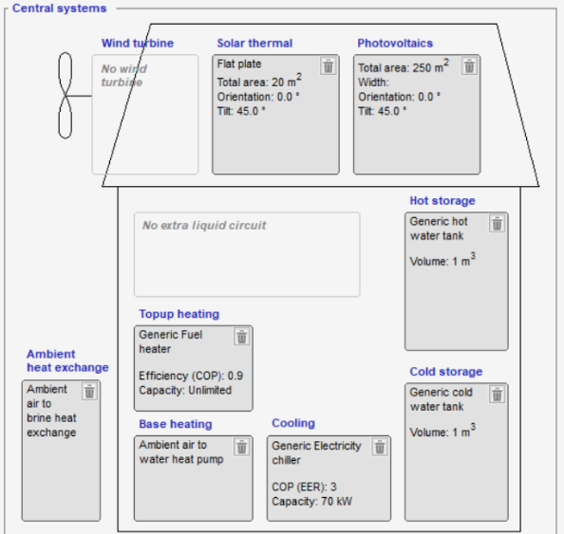
Heat Pump and Solar Thermal
Base cooling: 70kW
Base heating: 10kW
Chiller: Brine to Water
Ground heat exchange: 4 holes, length of 75m
Solar plates: area of 20m2
PV panels: area of 100m2

Slide 14
Results
Operating temperature | Higher than 21°C in winter and lower than (or equal to) 24°C in summer
CO2 | Values below 1000 ppm (vol.), as asked by the requirements
Total heating (excluding surroundings and downstairs) | 28 kW 37 W/m2 → SILVER
Total cooling (excluding surroundings and downstairs) | 66 kW 87 W/m2
PPD% | Less than 10% in all rooms → GOLD
Solar gain | Custom simulation from 20th March to 20th April shows a maximum solar gain below 25 W/m2 in every room → GOLD
BBR | 152, which is less than 1.8 BBR(=154) → BRONZE (Energy class E)

Slide 15
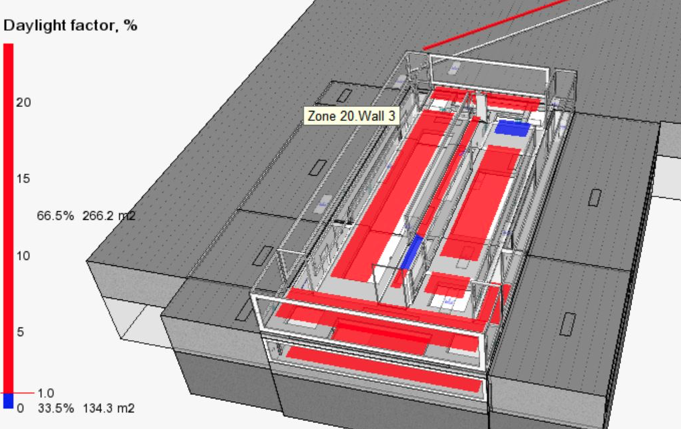
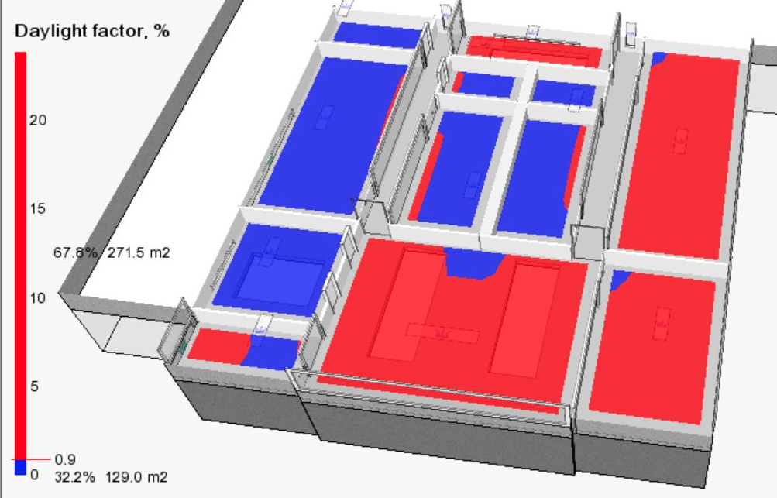
Daylight results
Upper floor Main floor
Daylight median is more than 1% in mostly all the rooms with windows

Slide 16
Questions
Is it ok to run the solar gain simulation from 20 March to 20 April, as we did in the Shading Exercise?
When do we need to simulate the cooling (Rome) and heating (Stockholm) energy consumptions ? We get different values depending on how long and when the simulation is. How do we improve it further more?
Are we supposed to change the number of occupants?
Is it correct to assume that the PI control is on when “the windows are open only during the period March 1st to November 1st if the temperature inside is higher than the setpoint (which is 24°C) and it is higher the outside temperature”
What is the indoor climate criteria?
What are the different meanings in the heating table? Do we have something wrong?
BBR calculation - for 1 month or for the entire year?
Simulation Time?
Can we lower the temperature in the corridors in winter?

